Slide 1
ACROPOLIS INSTITUTE OF TECHNOLOGY AND RESEARCH
INFORMATION TECHNOLOGY

Slide 2
SMART HOME MANAGEMENT SYSTEM
GUIDED BY:-
Dr. Kamal Sethi
SUBMITTED BY:-
Ashwini Lele
0827IT151022

Slide 3
CONTENT
Introduction
Objective
Solution Proposed
Diagrams
Survey
Expected outcomes
Benefits
Challenges
Conclusion

Slide 4
INTRODUCTION
SMART HOME MANAGEMENT SYSTEM

Slide 5
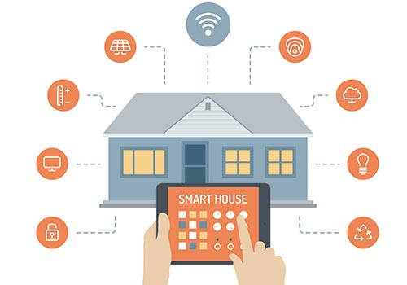

Slide 6
SMART HOME MANAGEMENT SYSTEM
Home automation refers to the use of computer and information technology to control home appliances and features (such as windows or lighting).
Smart home management system allow its user to leave switching on and off devices such as lights, Air conditioning, TVs, computers etc on the system while busy in doing other activities.
With home automation, you dictate how a device should react, when it should react, and why it should react.
Home automation is adopted for reasons of ease, security and energy efficiency.
Home automation can also provide a remote interface to home appliances or the automation system itself, to provide control and monitoring on a smart phone or web browser.

Slide 7
OBJECTIVE

Slide 8
OBJECTIVE
To develop a web application for smart home management system, that will provide an interface for user to avail the services such as switching on/off various household appliances only by a touch.
Web application will provide two modes of operations to user, that is, manual and automatic.

Slide 9
SOLUTION PROPOSED

Slide 10
SOLUTION PROPOSED
Interface for controlling appliances.
Simple interface for users.

Slide 11
USE CASE

Slide 12
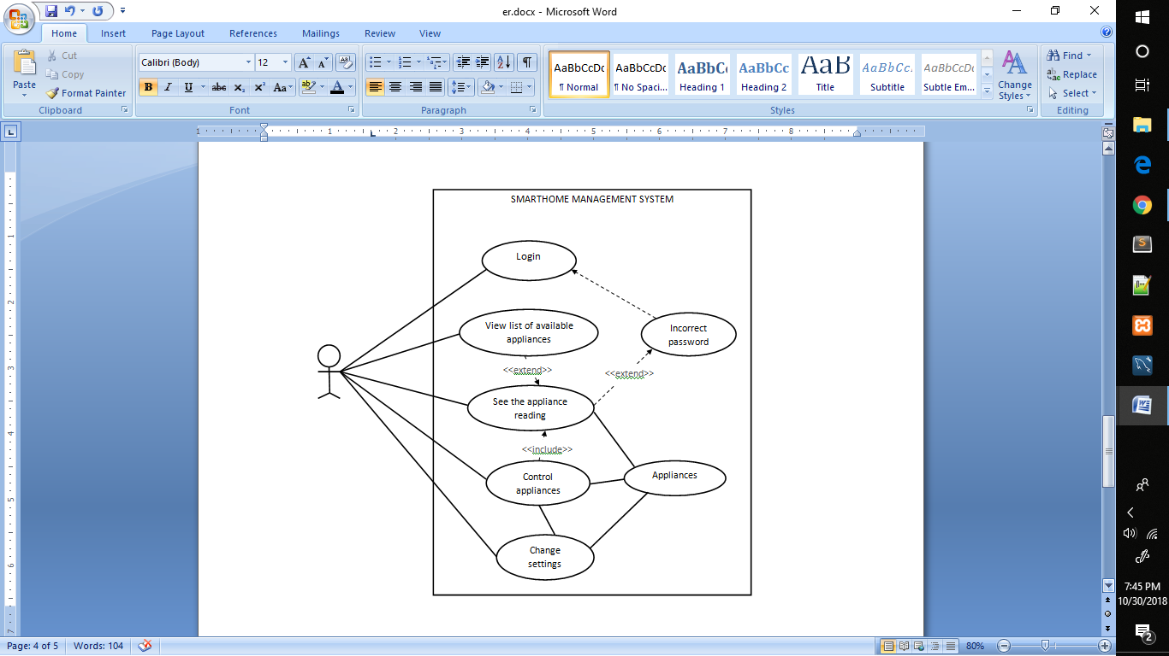

Slide 13
ER DIAGRAM

Slide 14
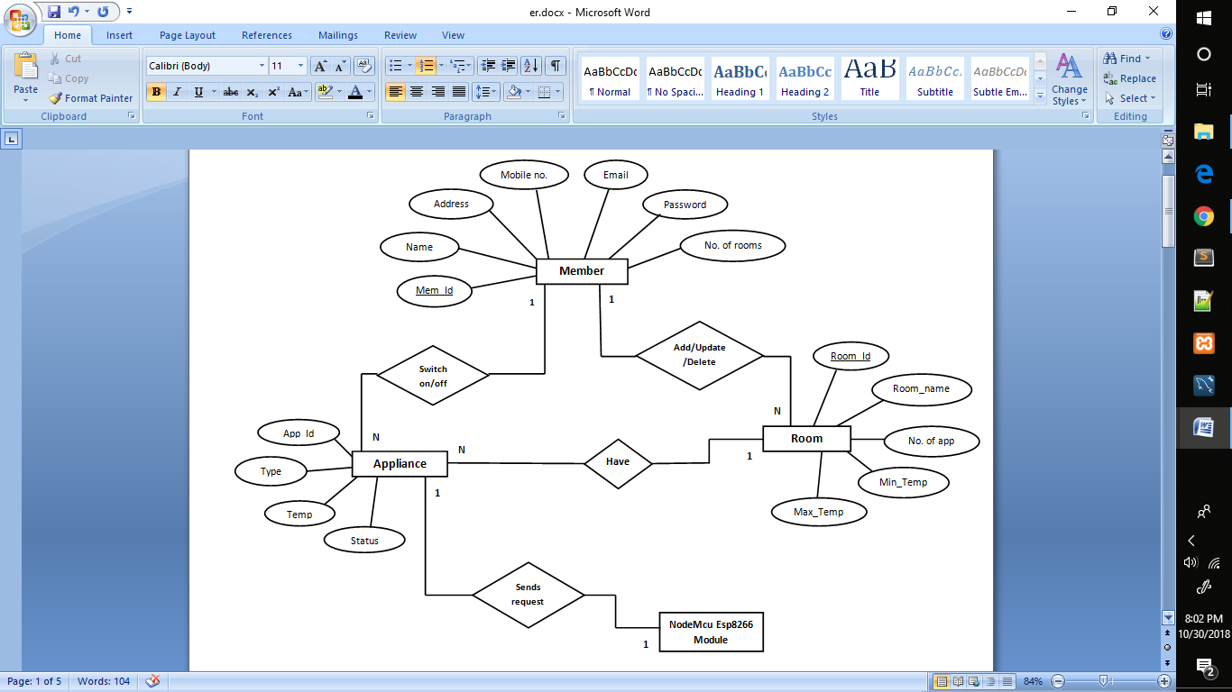

Slide 15
SEQUENCE DIAGRAM

Slide 16
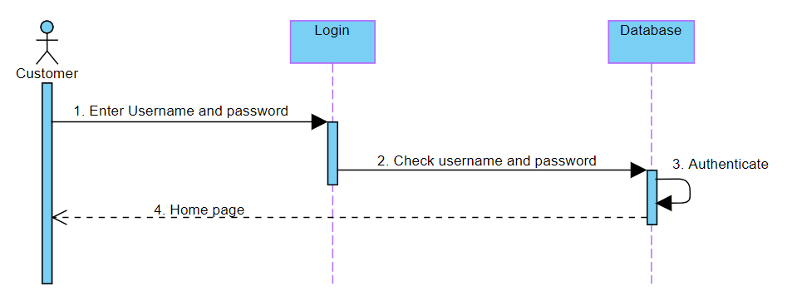

Slide 17
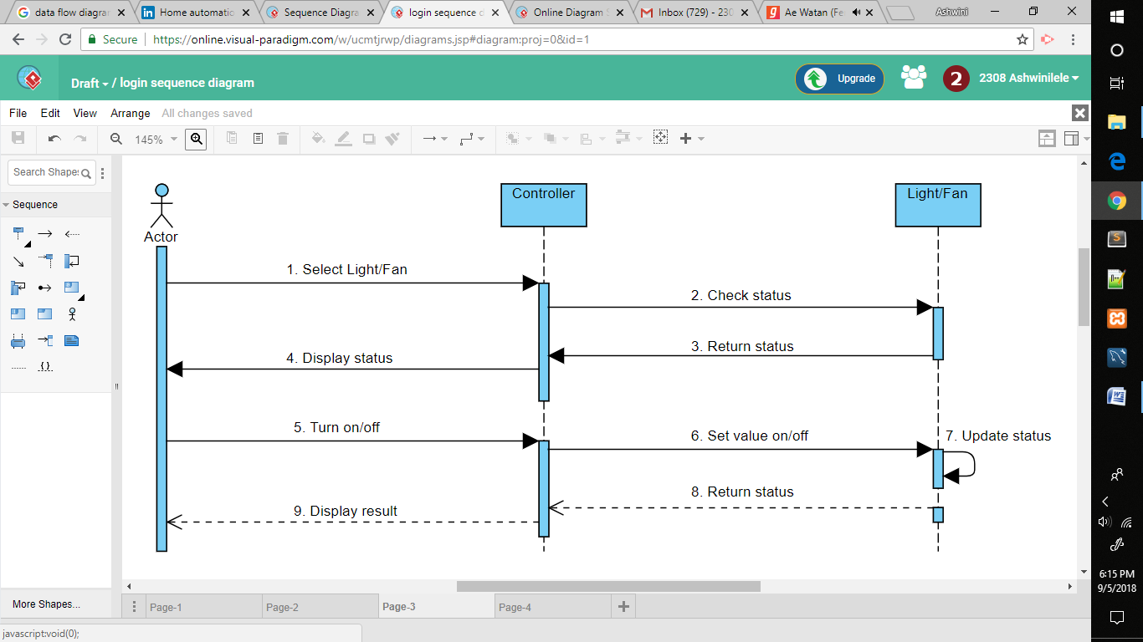

Slide 18
ACTIVITY DIAGRAM

Slide 19
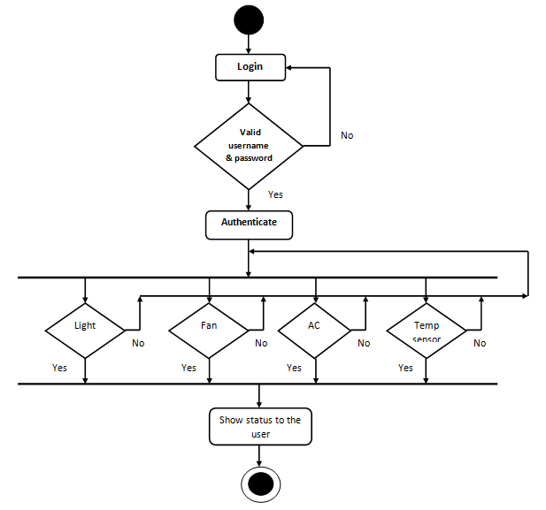

Slide 20
SURVEY

Slide 21
SURVEY
NestLearning Thermostat 3rd Generation
VeraEdge Controller
Compatible with Amazon Alexa for voice control.
Remembers desired temperatures and creates Auto-Schedules.
Automatically turns down temperatures when nobody’s home.
Guides users to choose a temperature that saves energy.
Works with Wi-fi and Z-wave.
The app controls the entire system across multiple platforms (PC/ Mac/ iOS/ Android Smartphones, Tablets and Desktops).
Controls up to 220 devices.
Remote access to homes and facilities with one-touch settings.

Slide 22
EXPECTED OUTCOMES

Slide 23
EXPECTED OUTCOMES
Ease of controlling lights and fans.
Increases convenience.
User friendly website.

Slide 24
PROJECT SCREEN SHOTS

Slide 25
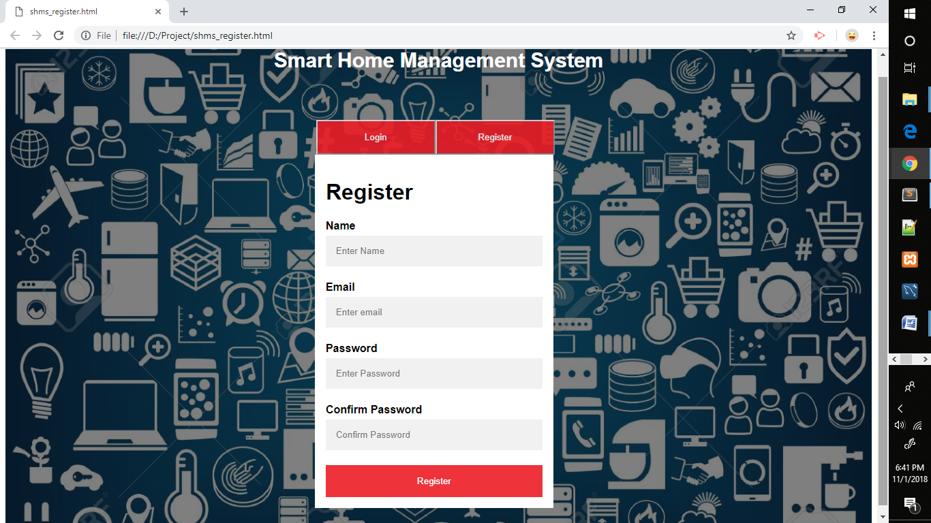

Slide 26
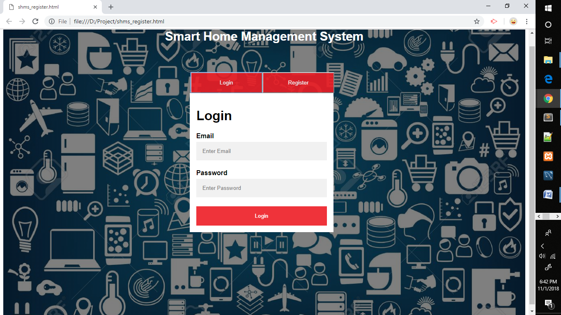

Slide 27
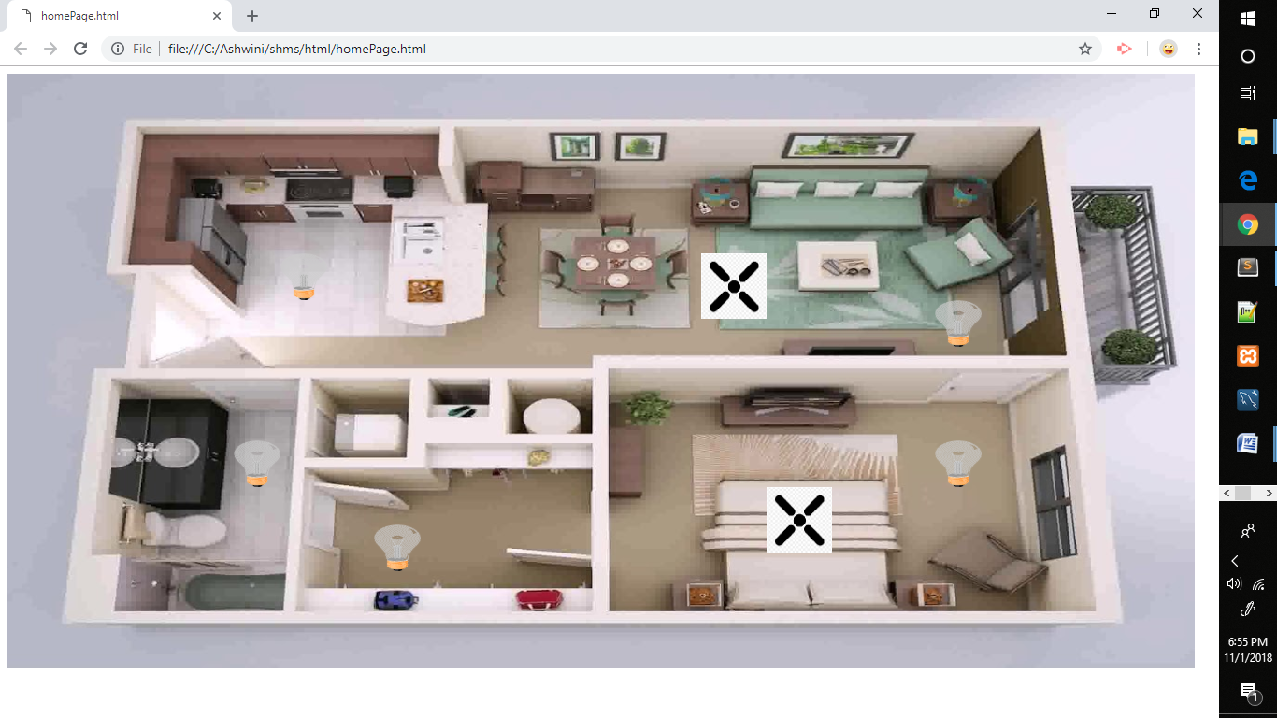

Slide 28
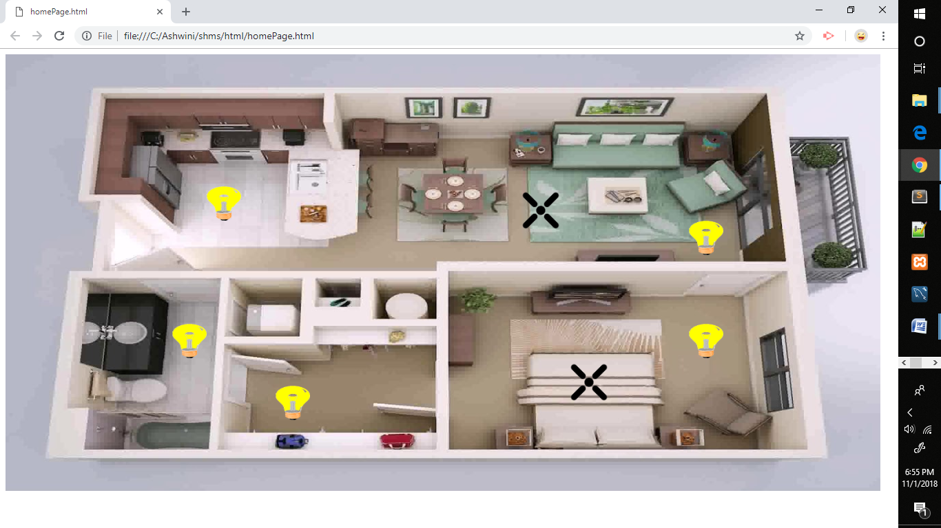

Slide 29
BENEFITS
BENEFITS OF SMART HOME MANAGEMEMNT SYSTEM

Slide 30
BENEFITS
A smart home makes life easier by imparting the ability to control the appliances remotely, irrespective of your location.
Besides, it also saves electricity and brings down the bills by sensing the presence of residents in a house and turns off the appliances when not in use.
A furnace can send an alert message when it needs cleaning, or a refrigerator when it needs service.
If no one is supposed to be home and the alarm system is set, the home automation system could call the owner, or the neighbors, or an emergency number if an intruder is detected.
In a nutshell, a smart home never lets you feel alone and takes care of everything that you wish for.

Slide 31
CHALLENGES
CHALLENGES OF SMART HOME MANAGEMENT SYSTEM

Slide 32
CHALLENGES
It’s quite a well-known fact that home automation is still limited to a few household because of its high cost and complexity.
It’s not as simple as it seems.
Moreover, since everything is automated, a smart home is subject to a lot of risk of being hacked allowing intruders to break-in. Once hacked, the whole control would be handed over to the hacker and then even the owner would lose access to his/her own house.

Slide 33
CONCLUSION

Slide 34
CONCLUSION
Home Automation is undeniably a resource which can make a home environment automated. People can control their electrical devices via these Home Automation devices and set up the controlling actions in the computer. We think this product have high potential for marketing in the future. At the moment the components are a bit too high to be able to produce these devices for an interesting price.

Slide 35
THANK YOU

